Slide 1
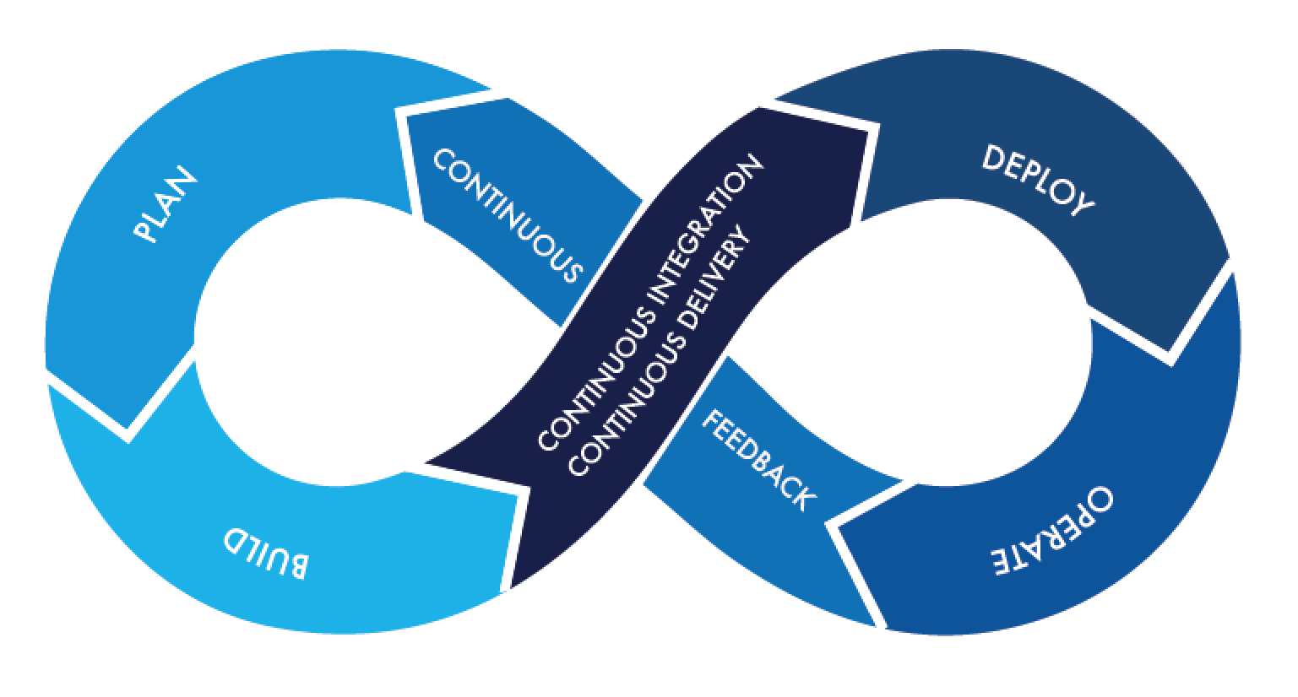
Docker & Kube

Slide 2
Ravi M
Clients Served:
IBM (DevOps, Docker & Kubernetes)
HP Enterprise (Kubernetes)
ORACLE (Docker & Kubernetes)
JPMC (Docker & Kubernetes)
CISCO (Docker & Kubernetes)
BMC (Docker & Kubernetes)
OPTUM (DevOps, Docker & Kubernetes)
NESS (Kubernetes)
DELOITTE (Kubernetes)
BANK OF NEW YORK (DevOps)
SUBEX LIMITED (Docker & Kubernetes)
DevOps University (DevOps, Docker & Kubernetes)
DevLabs Alliance (DevOps, Docker & Kubernetes)
EDUREKA (DevOps, Docker & Kubernetes)
SimpliLearn (DevOps, Docker & Kubernetes)
BROADRIDGE (Docker & WebSphere)
Docker Certified Associate
Certified Kubernetes Administrator
AWS Solutions Architect Associate
Certified Terraform Associate
ITIL V3 Foundation
WebSphere Application Server Admin
2

Slide 3

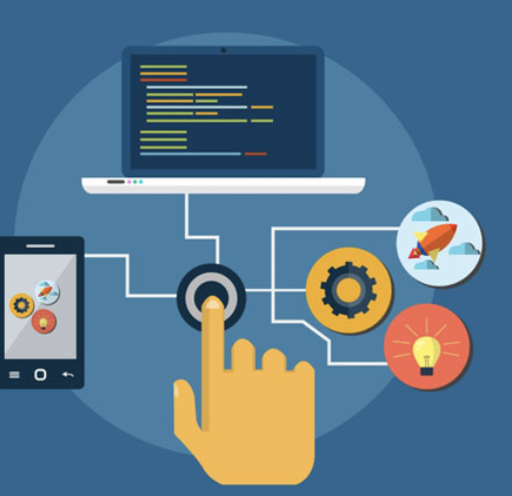
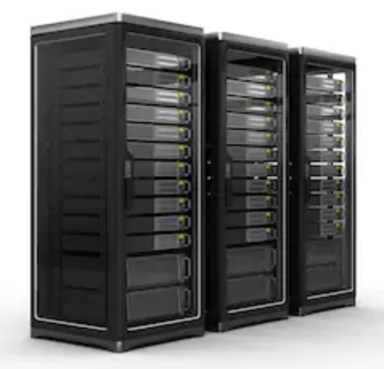
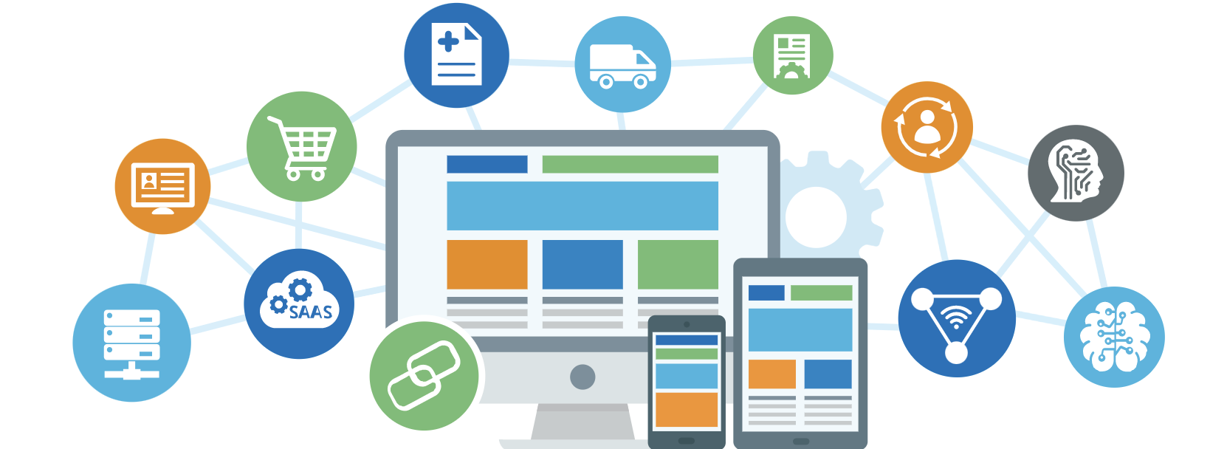
Basics...
Server Applications

Slide 4
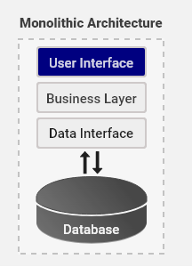
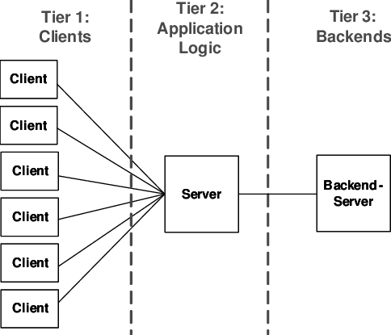
Application Architectures…..
3(N) Tier Architechture

Slide 5
Software Engineering
"The systematic, disciplined, quantifiable approach to the development, operation and maintenance of software“
-- IEEE
Goal:
Is to deliver an efficient and reliable software product to client OR to end user OR to market.

Slide 6
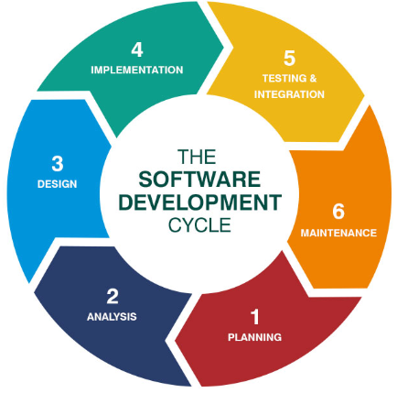
SDLC
SDLC defines the complete life cycle of software i.e. all the tasks involved in planning, creating, testing, and delivering a Software to client or market.
SDLC process aims to produce high-quality software that meets customer expectations

Slide 7
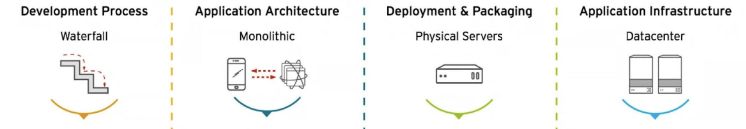
Evolution of IT

Slide 8
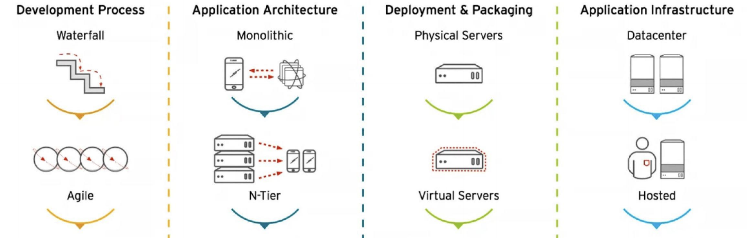
Evolution of IT

Slide 9
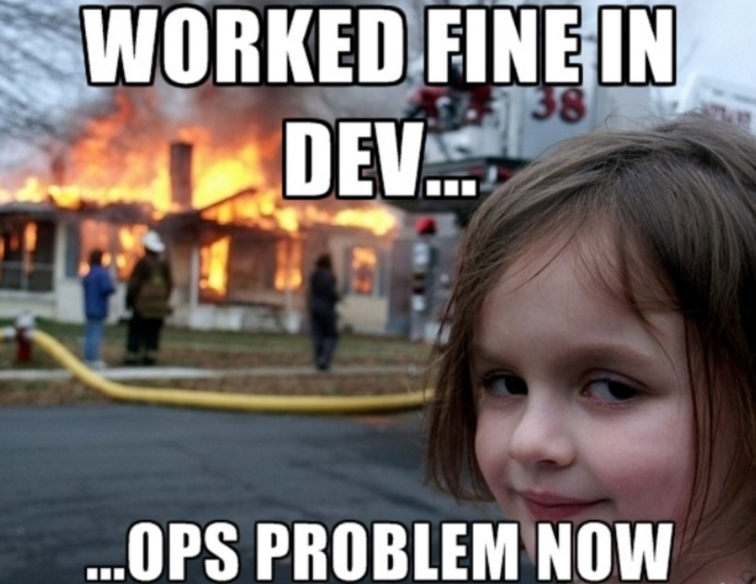

Slide 10
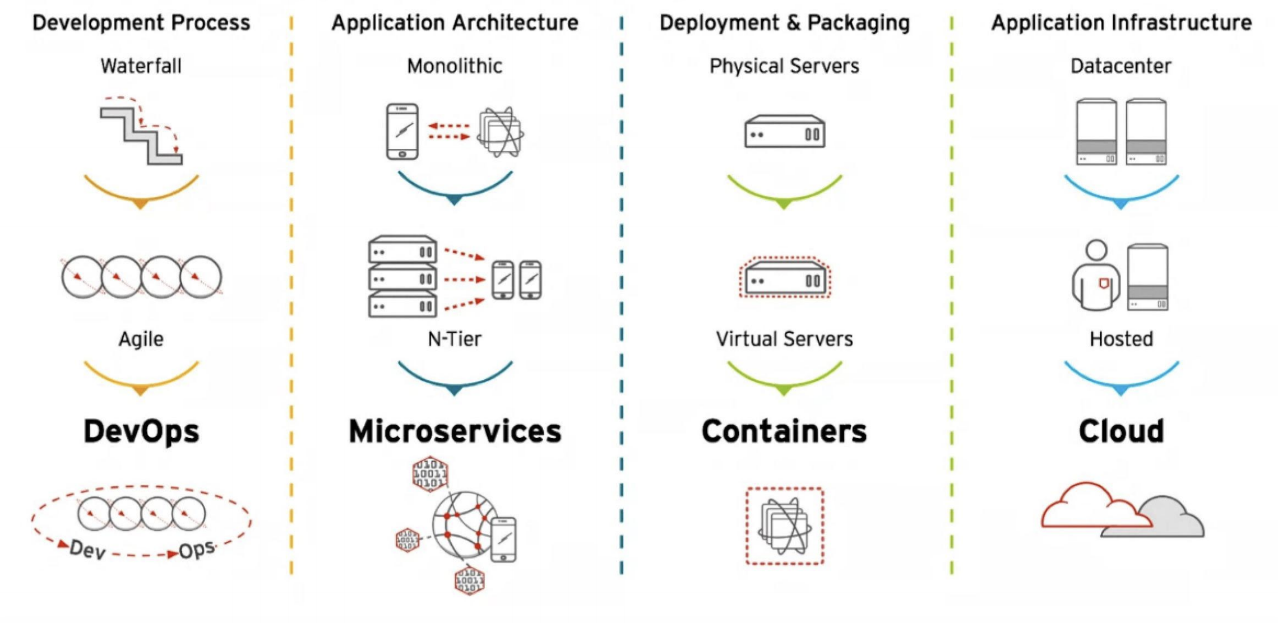
Evolution of IT

Slide 11
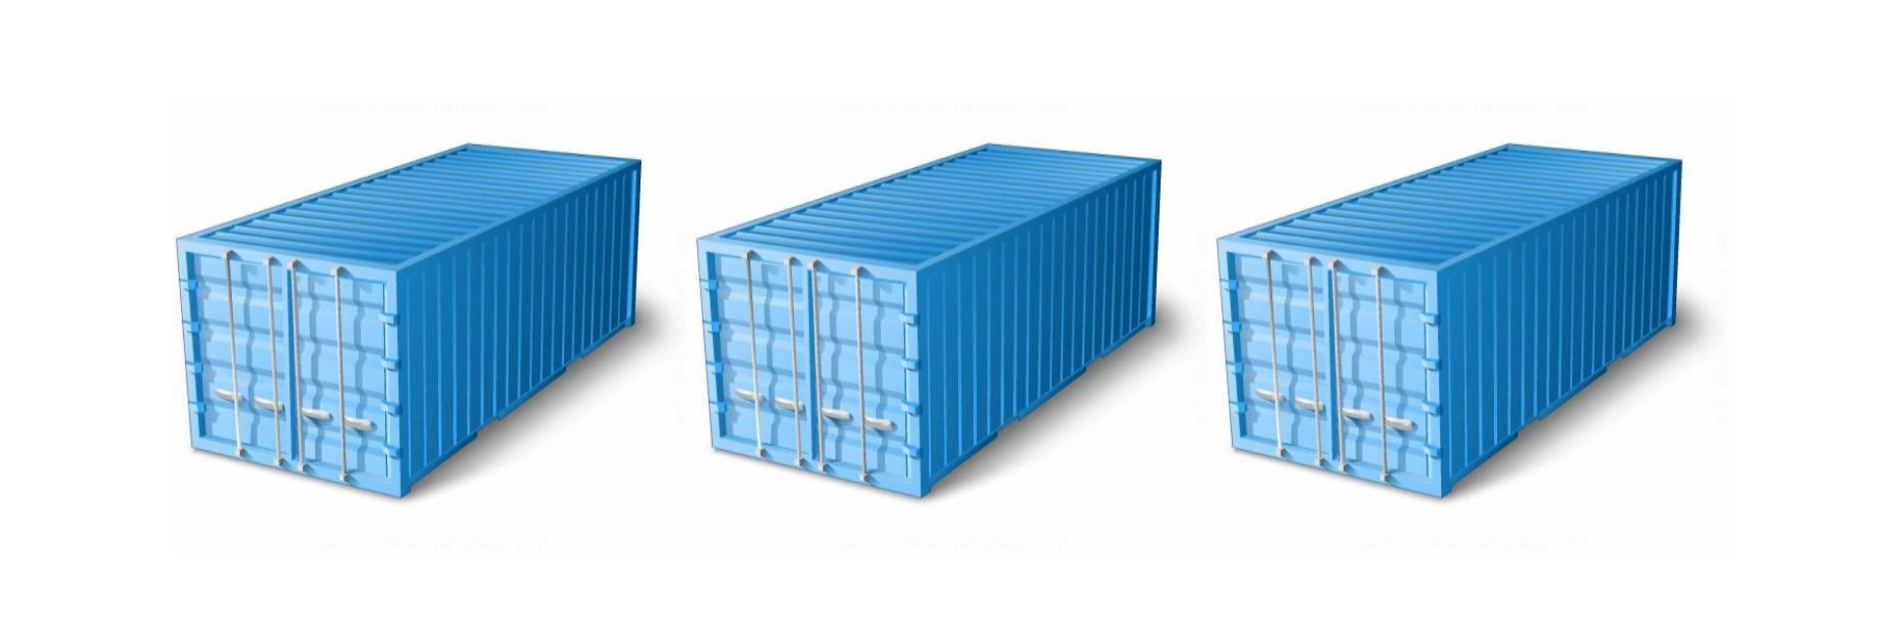
Need of Containers

Slide 12
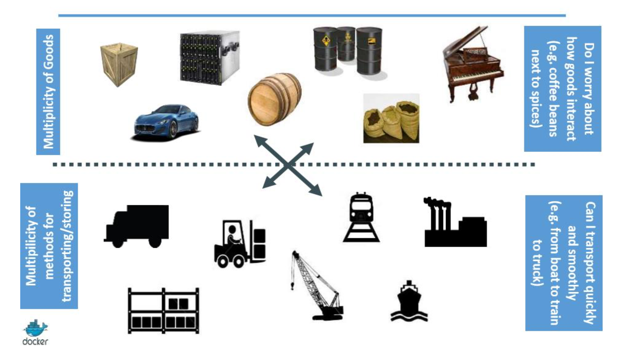

Slide 13
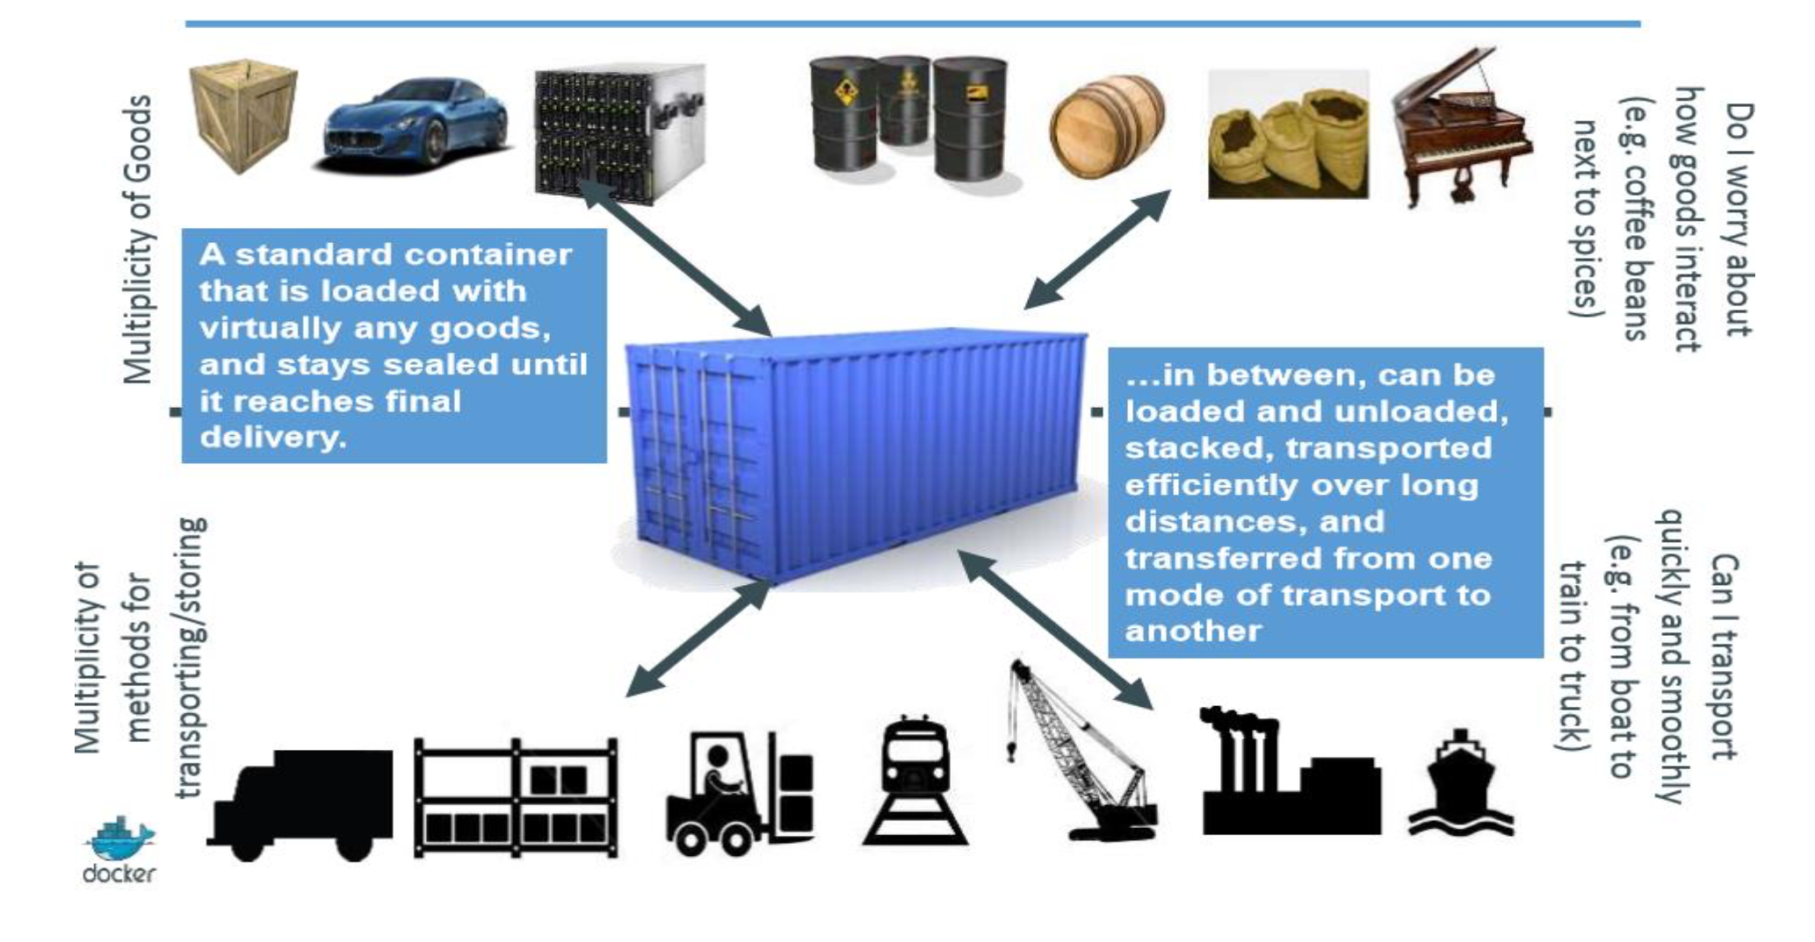

Slide 14
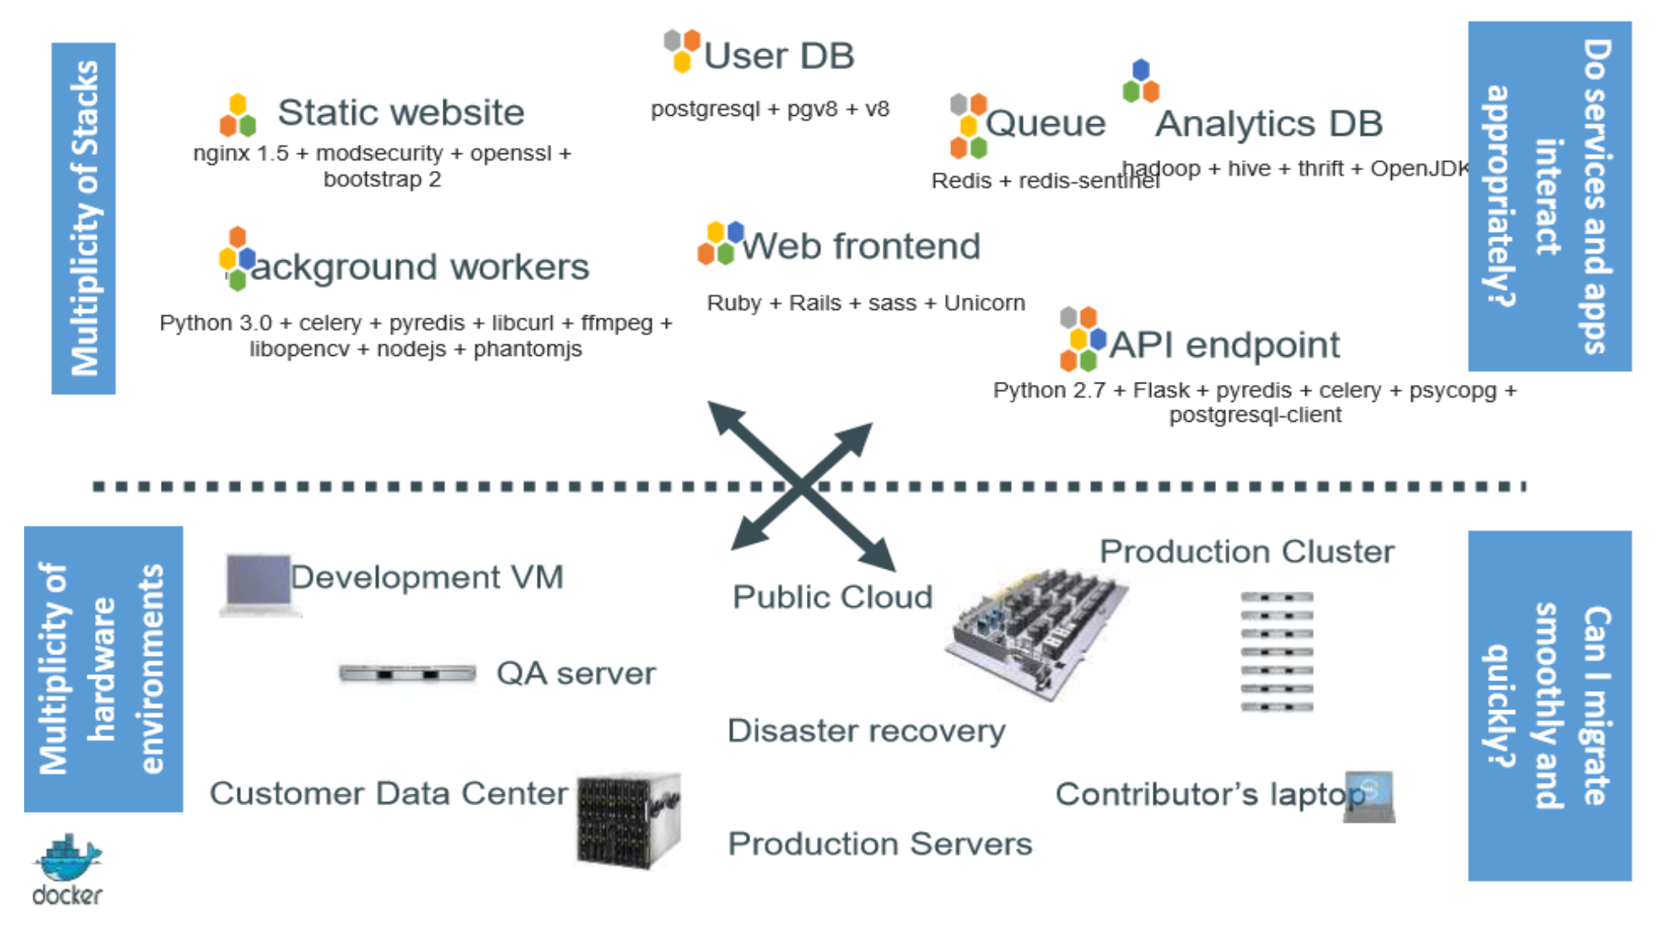

Slide 15
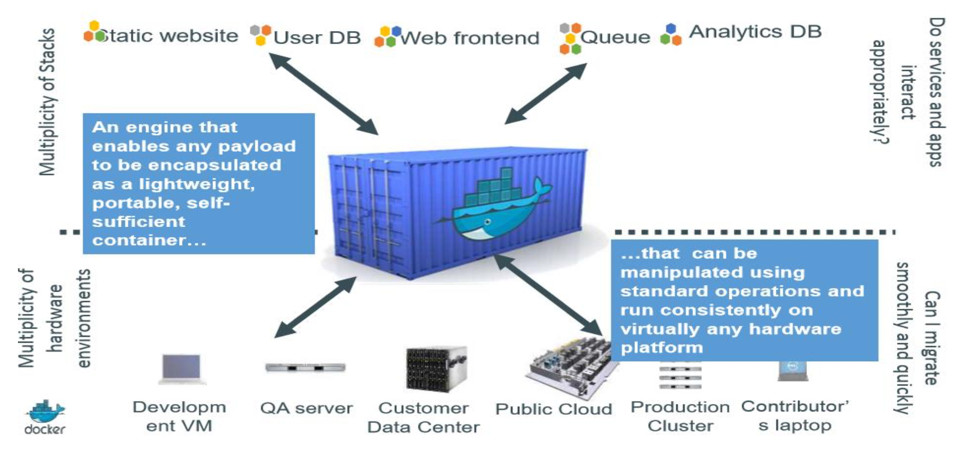

Slide 16
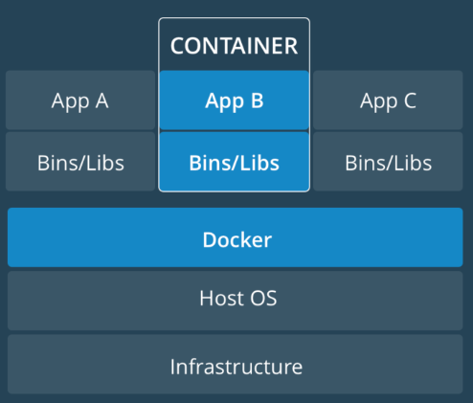
What Are Containers ?
Containers are way to host an application in multiple environments such as DEV, QA, IAT, PROD etc…
Container is simply a software package that has an application and all of its dependencies inside to run it.
Containers are. a streamlined way to build, test, deploy, and redeploy applications on multiple environments from a developer’s local laptop to an on-premises data center and even to the cloud.

Slide 17
Why Containers ?
Greater efficiency: Containers allow applications to be more rapidly deployed, patched, or scaled.
Less overhead: Containers require less system resources than physical or virtual machine environments because they don’t include full operating system.
Increased portability: Applications running in containers can be deployed easily to multiple different operating systems and hardware platforms.
More consistent operation: DevOps teams know applications in containers will run the same, regardless of where they are deployed.
Better application development: Containers support agile and DevOps efforts to accelerate development, test, and production cycles.

Slide 18
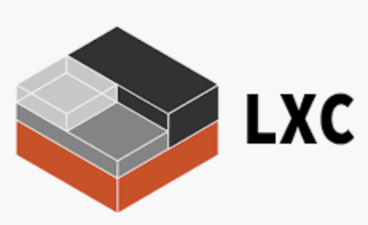
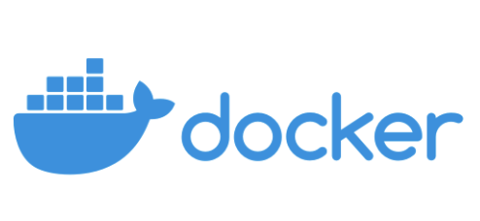



Technologies we have

Slide 19
What is Docker?
Docker is a software or containerization platform that runs on Linux and Windows. It helps to build, ship & run containers anywhere.
Docker is an. OS level Virtualization software that runs and deploys containers. In VMware terms, you can think of it as being similar to ESXi.
Docker provides a way to run applications securely isolated in a container, packaged with all its dependencies and libraries.
Docker Inc (Mirantis Now). is a company based out of San Francisco and is the overall maintainer of the open-source project. Docker, Inc. also has offers commercial versions of Docker.

Slide 20

Work.. Work.. Work..

Slide 21

How to Organize ??

Slide 22
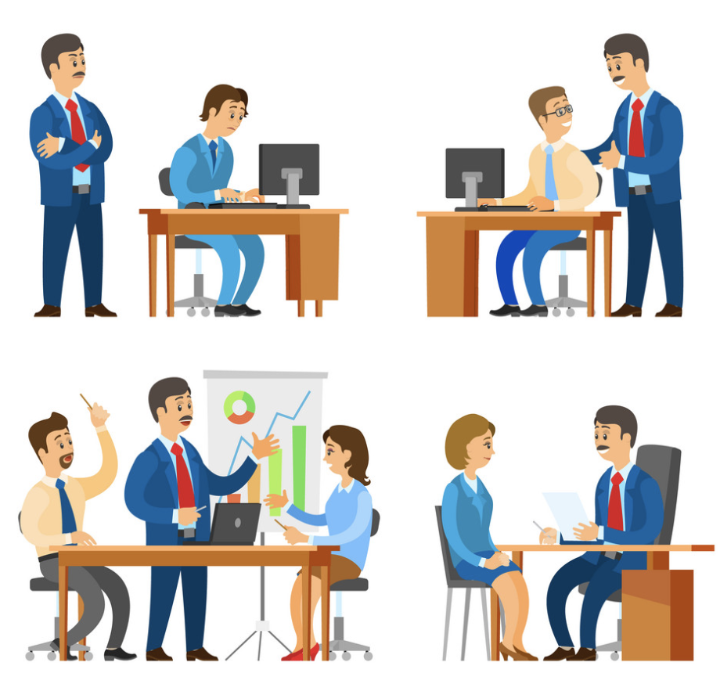
Why Manager ???
To Assign Work
To get New Projects
Leave Management
Work Management
Promotions
Adding More Members
Monitoring

Slide 23
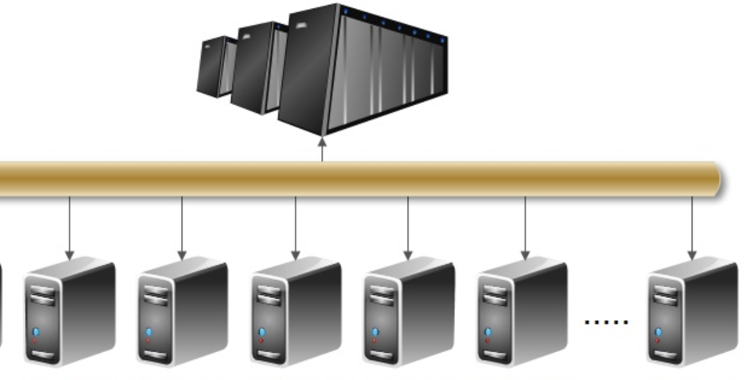
How to Manage More Containers ???

Slide 24
Why Container Orchestration ?
Hosting container-based applications in different environment brings many challenges to Infrastructure Teams & DevOps teams such as...
Which NODE suits the Container Requirement ?
Maintain the Desired State ?
How to Share the Load (User Requests) ?
Scalability ?
Auto Healing ?
Auto Scaling ?
ZERO Downtime Upgrades/ Rollbacks
Containers & NODEs communication
Security-- RBAC and Certificates

Slide 25
